Slide 1


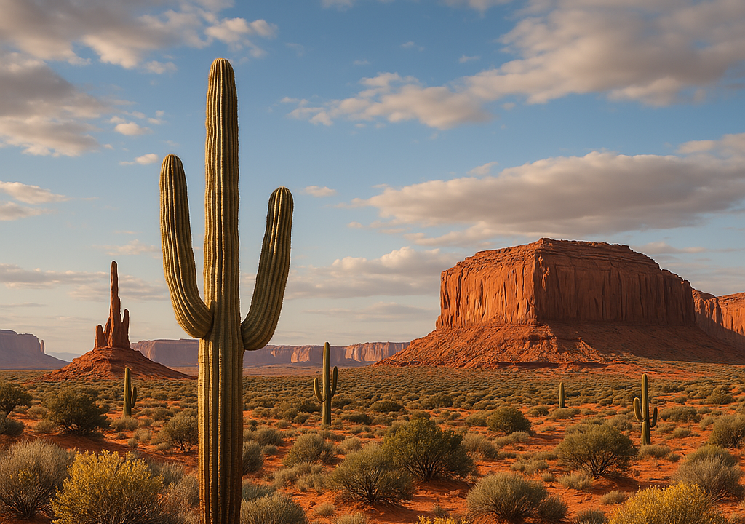
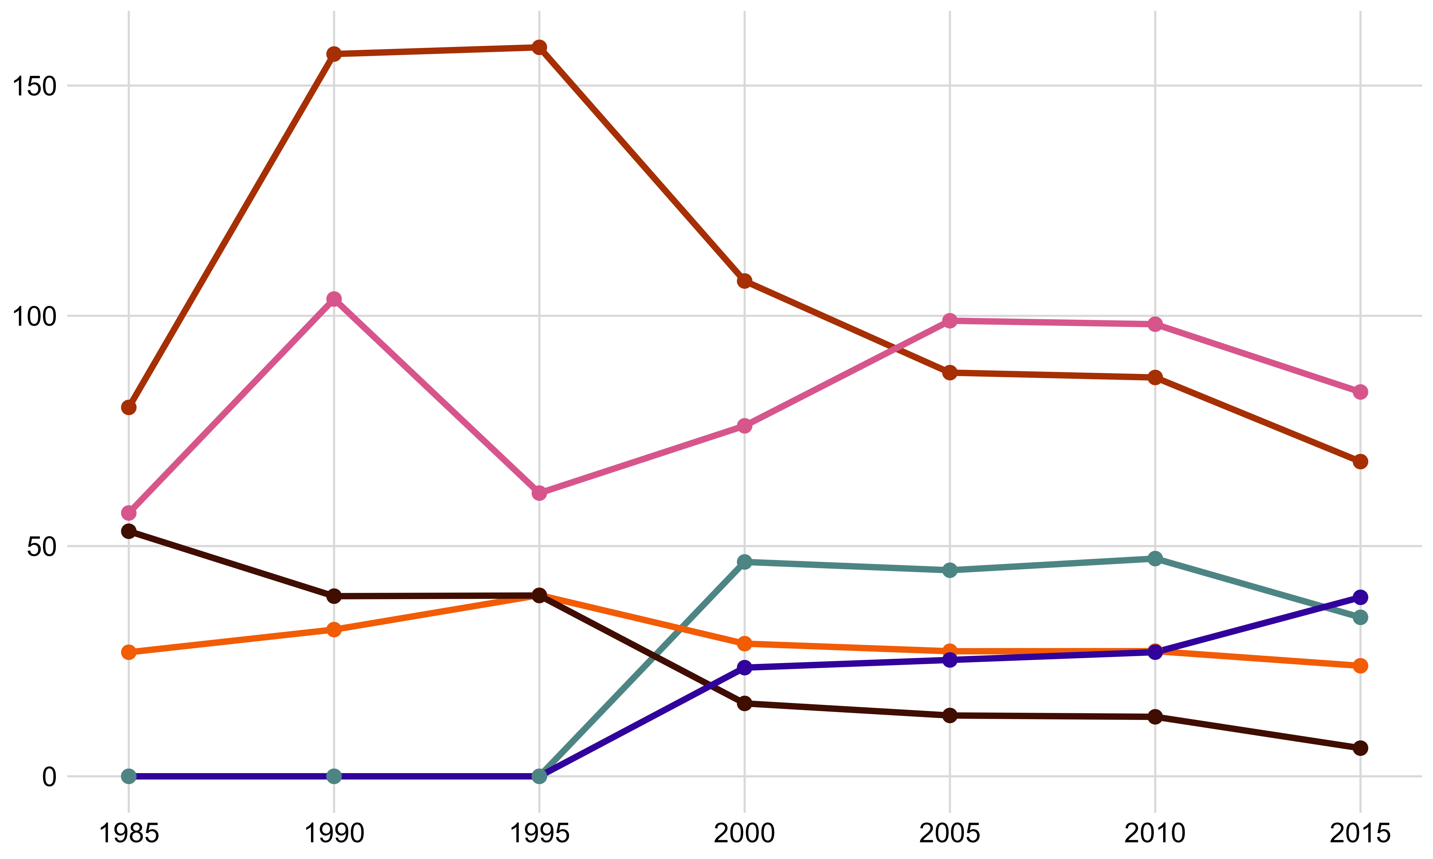
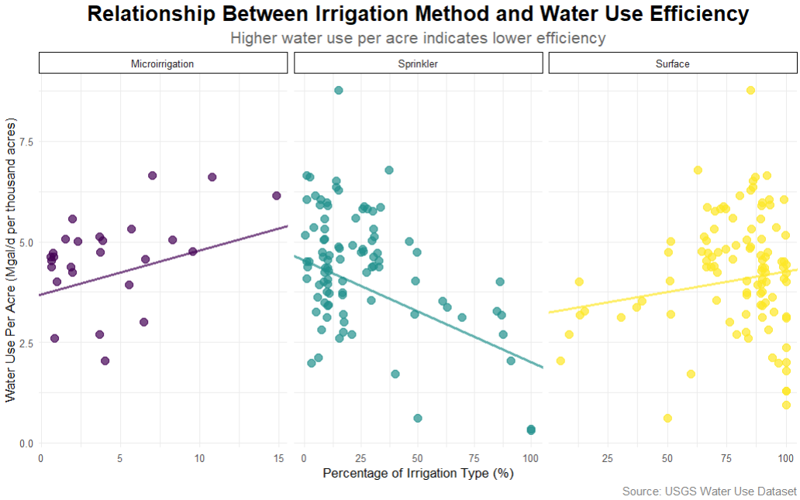
Arizona Water:
Jack Tomlon, Delila Medlin, Dr. Robert Buscaglia
The Pathogen and Microbiome Institute, Northern Arizona University, Flagstaff, AZ 86011
Problem
Arizona is facing a critical water crisis due to a combination of prolonged drought, climate change, and overuse of water resources. The Colorado River, a primary water source for the state, has experienced significant declines in runoff, leading to historically low reservoir levels in Lake Mead and Lake Powell. Between January 2000 and April 2023, these reservoirs' combined storage decreased by 33.5 million acre-feet, leaving total basin-wide storage sufficient to support average consumption for only 15 months. Addressing these challenges requires substantial reductions in water use and the implementation of sustainable management practices to stabilize and recover water storage levels.
Proportion of Irrigation method in Arizona
Year | Sprinkler | Microirrigation | Surface
1985 | 19.92% | 0.00% | 80.08%
1990 | 20.65% | 0.00% | 79.35%
1995 | 18.54% | 1.32% | 80.13%
2000 | 21.15% | 1.39% | 77.46%
2005 | 24.75% | 2.15% | 73.10%
2010 | 19.64% | 2.83% | 77.53%
2015 | 24.21% | 5.53% | 70.27%
Abstract
As of March 2025, a staggering 99% of Arizona was in a state of drought (US Drought Monitor 2025).
Decreases in precipitation in our state have brought about concerns for the future of Arizona’s water future, and how the state is going to sustain their growing population and water consumption rates. This project analyzes water production and consumption data from the United States Geological Survey (USGS) to identify anomalies and investigate sectors exhibiting unusual water loss in Arizona. The data, collected from publicly available USGS resources includes information on water withdrawals, usage by sector, and sources such as surface and groundwater. The goal is to uncover patterns and discrepancies that may indicate inefficiencies or areas for improved water management. Additionally, this analysis explores the potential ethical and environmental benefits of increasing the use of reclaimed water within Arizona’s water management strategy. By identifying opportunities to optimize water use and integrate sustainable practices, the project aims to support more informed decision-making for managing Arizona’s limited water resources
effectively
Conclusion
References

